Slide 1
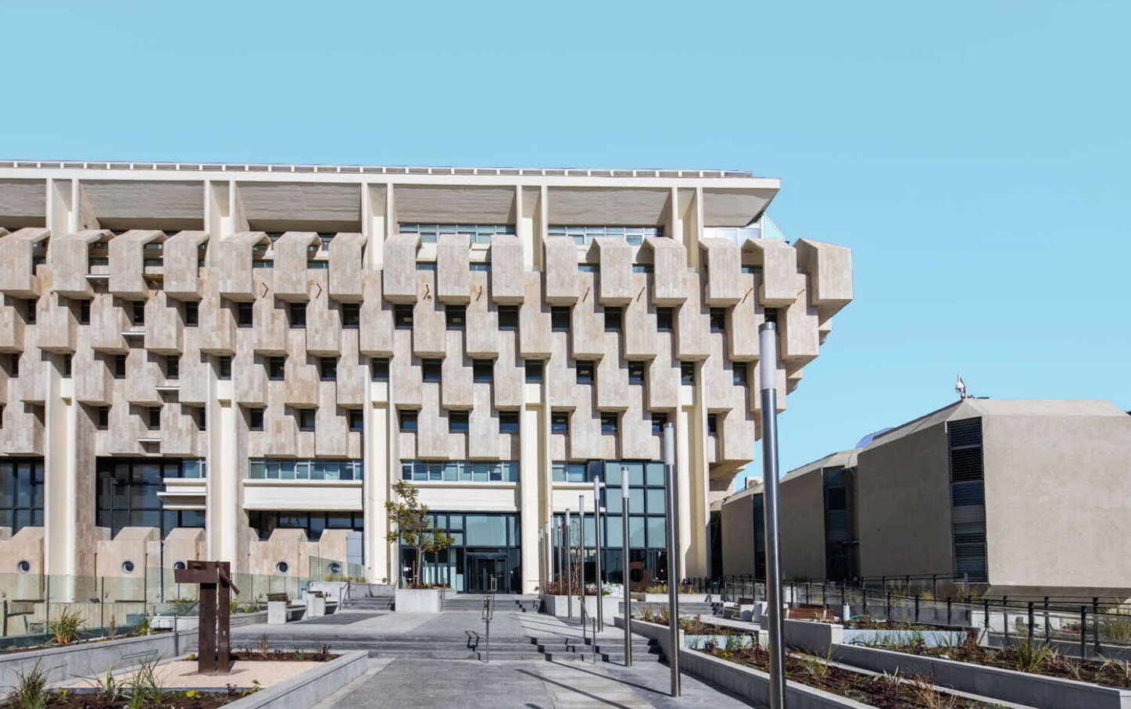


The Main Economic Data behind the Monetary Committee’s Policy Decision
July 6, 2026

Slide 2

The Monetary Environment

Slide 3
Inflation in the past 12 months was 1.9 percent
SOURCE: Based on Central Bureau of Statistics.

Slide 4
The CPI net of energy, fruit and vegetables was 1.6 percent, and the CPI net of taxation and regulation was 1.9 percent
SOURCE: Based on Central Bureau of Statistics.

Slide 5
Inflation among the nontradable components was 2.9 percent, and inflation among the tradable components was 0.4 percent
Figure 3: Contribution of Main CPI Components to Annual Inflation, May 2024 – May 2026
SOURCE: Based on Central Bureau of Statistics.

Slide 6
The inflation dynamics of the overall CPI moderated.
SOURCE: Based on Central Bureau of Statistics.

Slide 7
According to forecasters’ projections, inflation is expected to decline slightly in the coming months, and then stay near the midpoint of the target range.
SOURCE: Forecasters reports to the Bank of Israel.

Slide 8
One-year inflation expectations from the various sources are below the midpoint of the target range.
*Up to date as of 02.07.26
SOURCE: Bank Of Israel.

Slide 9
Inflation expectations for ranges beyond the second year are slightly below the midpoint of the target range.
*Up to date as of 02.07.26
SOURCE: Bank Of Israel.

Slide 10
Home prices declined by 0.3 percent in March-April, and by 1.3 percent in the past year.
SOURCE: Based on Central Bureau of Statistics.

Slide 11
New mortgage borrowing totaled about NIS 9.5 billion in May, seasonally adjusted.
SOURCE: Based on banks’ reports to the Banking Supervision Department.

Slide 12

Real Economic Activity

Slide 13
The Research Department’s growth forecast is 4.0 percent in 2026 and 5.5 percent in 2027.
SOURCE: Based on Central Bureau of Statistics.

Slide 14
The aggregate balance in the Business Tendency Survey for May increased, but has not yet returned to its level from before Operation Roaring Lion.
SOURCE: Based on Central Bureau of Statistics.

Slide 15
Credit card expenditures are slightly above the long-term trend line.
SOURCE: Based on Central Bureau of Statistics, SHVA.

Slide 16
Capital raised by high-tech firms in the second quarter was similar to the previous quarter, but lower than in the final two quarters of 2025.
SOURCE: Based on IVC.

Slide 17
Government revenues from direct taxes are above the trend line.
SOURCE: Based on Ministgry of Finance, National Insurance Institute.

Slide 18
The broad unemployment rate declined to 3 percent. The employment and participation rates among the prime working ages remained stable.
SOURCE: Based on Central Bureau of Statistics.

Slide 19
The job vacancy rate increased slightly, to 4.2 percent in May. The ratio of job vacancies to the unemployed is high.
SOURCE: Based on Central Bureau of Statistics.

Slide 20
Nominal wages in the three months from March to May increased by 6.8 percent in annual terms relative to the same period last year.
SOURCE: Based on Central Bureau of Statistics.

Slide 21
The number of non-Israeli workers in the economy remains lower than before October 7, 2023.
SOURCE: Based on Central Bureau of Statistics.

Slide 22
Building completions, building starts, and building permits are at high levels.
SOURCE: Based on Central Bureau of Statistics.

Slide 23
Goods exports increased in May, and services exports are at high levels.
SOURCE: Based on Central Bureau of Statistics.

Slide 24
Goods imports were at high levels in May.
SOURCE: Based on Central Bureau of Statistics.

Slide 25
The rate of companies reporting constraints in equipment and raw materials increased during Operation Roaring Lion and declined thereafter.
SOURCE: Based on Central Bureau of Statistics.

Slide 26

The Financial Environment

Slide 27
The shekel depreciated since the last interest rate decision, with volatility.
SOURCE: Based on Bloomberg.

Slide 28
The yields on 10-year Israeli government bonds declined.
SOURCE: Based on Bloomberg.

Slide 29
Corporate bond spreads remain low.
SOURCE: Bank Of Israel.

Slide 30
The rate of companies reporting a credit constraint declined in May.
SOURCE: Based on Central Bureau of Statistics.

Slide 31
Local equity indices declined during the reviewed period.
SOURCE: Based on Bloomberg.

Slide 32
Israel’s risk premium is close to its level of prior to October 7, 2023.
SOURCE: Based on Bloomberg.

Slide 33

The Global Economy

Slide 34
Investment houses’ growth forecasts remain largely unchanged.
Numbers in red represent the previous forecast.
SOURCE: Based on Bloomberg.

Slide 35
Oil and commodity prices declined markedly during the reviewed period.
SOURCE: Based on Bloomberg.

Slide 36
World trade continues to expand.
SOURCE: Based on CPB .

Slide 37
The global Purchasing Managers Index is at a level indicating expansion.
SOURCE: Based on Bloomberg.

Slide 38
Global inflation increased sharply. Inflation in Israel is stable.
SOURCE: FRED, ECB, Bank of Israel.

Slide 39
In their most recent decisions, the ECB and the Bank of Japan raised their rates by 25 basis points, and the Fed left its rate unchanged.
SOURCE: Based on Bloomberg.

Slide 40
In the US, the interest rate path includes one increase and a 50% likelihood of a second increase within one year, and in Europe the path includes one more rate increase within one year.
figure 35: interest rate path
SOURCE: Based on Bloomberg.

